Slide 1

Team : 06
Food brand understand customer trend
GUIDANCE BY : PAVITHRA KANNAN MAM

Slide 2




Team Members
JAGRUTI DESALE
SANSKAR CHOUDHARI
ADITYA SINGH

Slide 3

Project Introduction
Food delivery platforms like Swiggy and Zomato generate huge volumes of customer feedback in the form of ratings, reviews, and order data. This feedback contains valuable insights about customer preferences, satisfaction levels, and product performance. However, businesses often fail to leverage this raw data effectively due to its unstructured nature.
Our project aims to analyze customer feedback using Power BI to transform ratings into meaningful insights. We classified customer feedback into Positive, Average, and Negative sentiments, enabling a deeper understanding of customer experiences.

Slide 4
Project Overview
Focus on analyzing customer behavior toward food brands using collected data.
Utilized Power BI for visualization and analysis.
Identified seasonal trends, demand patterns, and brand performance.
outcome
Understanding customer preferences for better business decisions.

Slide 5
Key Features
Collection & preprocessing of sales and customer feedback data.
Sentiment analysis (Excellent>4.5, Good>4, Average>3.5, Poor).
Price categories (Low: <300, Medium: 300-600, High: >600, premium: >1000)
Delivery Speed (Fast: <45 Min, Medium: 46-60 Min, Slow: >60 Min)
Interactive Power BI dashboards with charts, filters, and drill-downs.
Price-wise and product-wise comparison.
Region-based and demographic insights.

Slide 6


Milestones
Data Collection & Cleaning
Structured Dataset Creation
Dashboard Development
Insights & Recommendations
Power BI dashboard with :
Product-wise sentiment analysis
Region-wise preferences
Time-based sentiment trends
Outputs Delivered

Slide 7
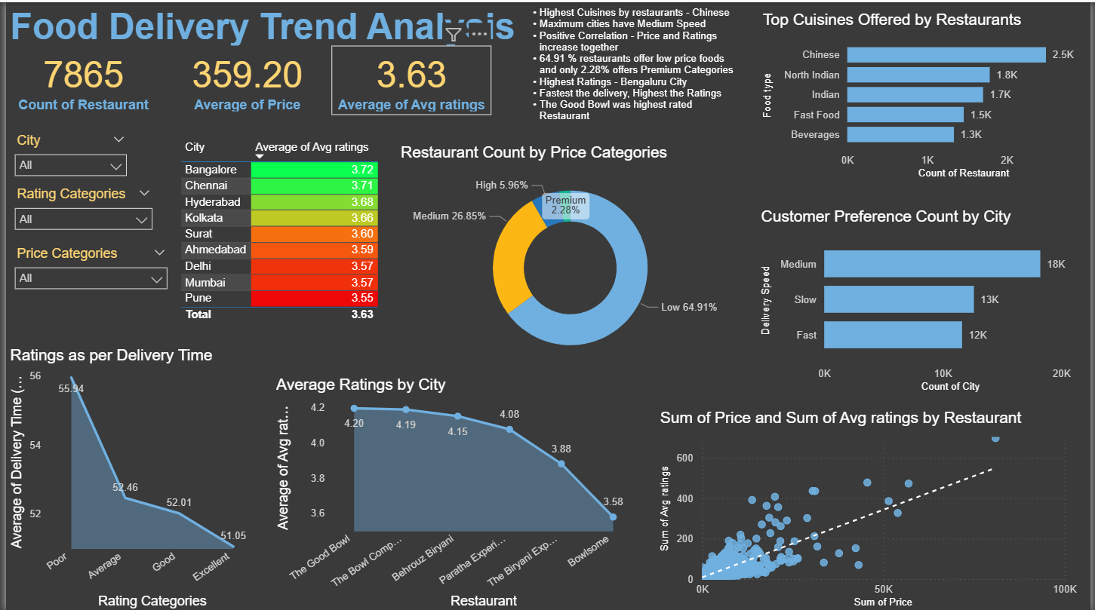
Dashboard overview
Key Insights :
City-Wise Ratings
Pune (3.55) & Mumbai (3.57) are the lowest → signals need for service/menu improvement.
Price Category Distribution
64.9% of restaurants fall in low price → highly price-sensitive market.
Only 2.28% restaurants serve premium segment → untapped opportunity for premium offerings.
Cuisines Popularity
High demand in Indian metros, but over-saturation risk in Chinese category.
Delivery Time & Ratings
Faster delivery = higher ratings.
Poor/slow delivery time strongly reduces customer satisfaction.
Food Delivery Trend Analysis

Slide 8
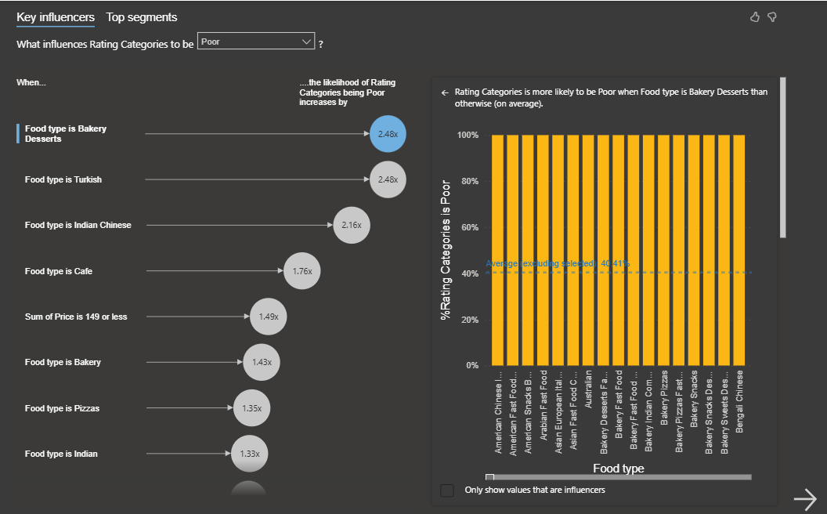
Dashboard overview
Key Influencers
Key Insights :
Food Categories Linked to Poor Ratings
Bakery Desserts → 2.48x more likely to receive poor ratings.
Turkish & Indian Chinese food → consistently underperforming in customer feedback.
Cafes & low-cost bakery items also prone to dissatisfaction.
Price & Quality Issue
Lower price ranges are associated with poorer feedback, possibly due to compromises in quality or service.

Slide 9
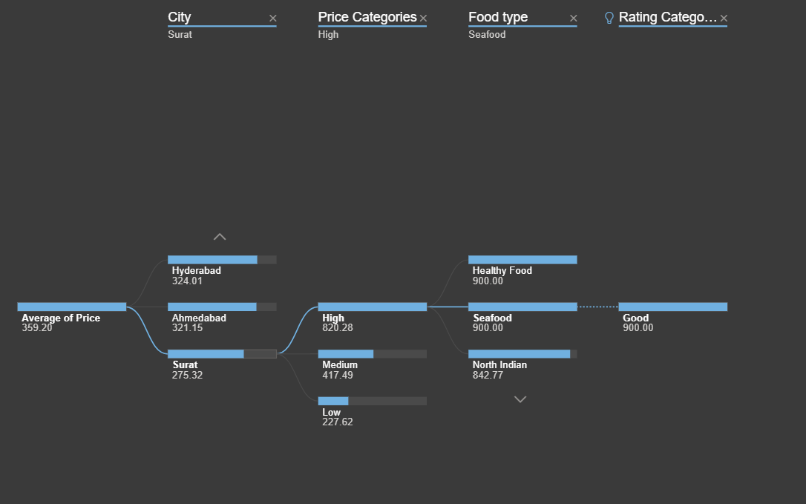
Dashboard overview
Decomposition Tree
Key Insights :
City-Level Pricing Differences
Surat has the lowest average price (275), while other cities like Hyderabad (324) and Ahmedabad (321) are higher.
Indicates regional pricing sensitivity — what works in one city may not in another.
Impact of Price Categories
High-priced restaurants (~820 average) consistently earn better ratings.
Medium and Low-price categories often correlate with average to poor reviews.
Food Types That Drive Good Ratings
Seafood and Healthy Food under High Price earn excellent ratings.
Suggests customers are willing to pay more for premium, health-focused, and niche food types.

Slide 10
IMPACT
Enabled restaurants to track customer satisfaction more effectively.
Highlighted seasonal and regional food trends
Identified problem areas (e.g., low ratings due to delivery issues).
Provided a data-driven decision-making tool for food businesses.

Slide 11
Milestones
Power BI dashboards created to visualize sentiment trends.
Use of DAX measures to calculate :
Positive feedback ratio
Sentiment changes over time
Review Volume & Sentiment Breakdown
Review Volume & Sentiment Distribution chart

Slide 12

objective
The primary objective of Milestone 2 is to analyze customer feedback through sentiment classification in order to gain actionable insights that can help food brands improve their services and offerings. Customer feedback, provided as ratings and reviews, holds a wealth of information about customer preferences, satisfaction levels, and pain points. However, this feedback is often unstructured and difficult to interpret without proper tools.

Slide 13
objective
To make sense of the feedback, we classified reviews into four distinct sentiment categories based on their ratings :
Excellent Reviews (Rating > 4.5)
These are highly satisfied customers who had a superior experience with the food, service, or delivery. Understanding the characteristics of excellent reviews helps identify best practices and areas where the brand excels.
Good Reviews (Rating between 4.0 – 4.5)
These reviews reflect satisfied customers who had a positive experience but may have encountered minor issue. Analyzing this category helps to reinforce strengths while recognizing areas for minor improvements.
Average Reviews (Rating between 3.5 – 4.0)
These reviews indicate a mixed experience. Customers were neither highly satisfied nor dissatisfied. Studying this group helps understand the common reasons for mediocrity, enabling targeted improvements.
Poor Reviews (Rating below 3.5)
These reviews represent dissatisfied customers who likely faced significant issues with food quality, delivery speed, or service. Insights from this category are critical in identifying gaps and driving corrective actions.

Slide 14
objective
Customer Experience Insights :
By categorizing feedback, brands can pinpoint what aspects of the service are working and what needs urgent attention.
Data-Driven Decisions :
Structured sentiment analysis helps management make informed decisions rather than relying on anecdotal feedback.
Trend Monitoring :
Tracking sentiments over time reveals patterns, such as seasonal dips in satisfaction or regions with consistently poor service.
Targeted Improvements :
For example, if a specific cuisine or price range is frequently associated with negative reviews, adjustments in menu offerings, pricing, or delivery methods can be implemented.
Customer Retention :
Understanding customer dissatisfaction early allows businesses to intervene and enhance customer loyalty.

Slide 15


Key Insights from Sentiment Analysis
Review Volume & Sentiment Breakdown :
49K total reviews analyzed
899 positive reviews (1.85% excellent)
17K good reviews (34.43%)
11K average reviews (23.33%)
20K poor reviews (40.39%)
Average Ratings & Delivery Time49K total reviews analyzed :
Average rating: 3.63
Average delivery time: 53.90 mins → slower delivery linked to lower satisfaction
Regional Preferences :
Ratings vary by city; Pune and Mumbai have the lowest ratings
Delivery time longer in certain areas correlates with dissatisfaction
Cuisine & Price Insights :
Certain cuisines like Bakery Desserts more likely to get poor feedback
High-priced restaurants generally receive better ratings → customer willingness to pay for premium options
Cuisine Preferences and Sentiment :
Bakery Desserts → more poor reviews.
Turkish & Indian Chinese → underperforming.
Seafood & Healthy → get top ratings.
Seasonal and Time-Based Trends :
Sentiment varies by month → festive seasons and order surges impact service quality.
Poor reviews spike during high-demand periods → brands should enhance logistics and staffing during peak times.

Slide 16
Key Insights from Sentiment Analysis
1. Review Volume & Sentiment Distribution
We analyzed a total of 49,000 customer reviews, and classified them into four categories :
Excellent (1.85%): Around 899 reviews indicated customers were extremely satisfied with the food, service, or delivery experience. These reviews often highlighted factors such as freshness, taste, and prompt delivery.
Good (34.43%): About 17,000 reviews represented satisfied customers who were happy with their experience but may have faced minor issues like delays or inconsistent portion sizes.
Average (23.33%): Approximately 11,000 reviews showed mixed feedback, indicating customers were neither strongly satisfied nor dissatisfied. These reviews often pointed to mediocrity, such as bland taste or average presentation.
Poor (40.39%): Nearly 20,000 reviews expressed significant dissatisfaction. These reviews pointed to issues like late delivery, poor packaging, inaccurate orders, or substandard taste and service.

Slide 17
Key Insights from Sentiment Analysis
2. Relationship Between Ratings and Delivery Time
The average rating across all reviews is 3.63, which is closer to the neutral zone than highly positive.
The average delivery time is 53.90 minutes, and the analysis shows that longer delivery times are directly linked with lower ratings.
Orders delivered in under 45 minutes tend to receive better feedback.
Orders that take more than 60 minutes are significantly associated with poor reviews.
Key Takeaways :
Improving delivery efficiency is one of the most actionable areas to enhance customer satisfaction.
Ensuring timely deliveries could turn average and poor reviews into good or excellent ones.

Slide 18
Key Insights from Sentiment Analysis
3. Regional Insights – City-wise Sentiment Trends
Pune and Mumbai have the lowest average ratings at 3.55 and 3.57 respectively, indicating challenges in these urban areas.
Cities like Surat, Hyderabad, and Ahmedabad show variations in average pricing and satisfaction, highlighting the need for region-specific strategies.
Key Takeaways :
Regions with lower ratings may need focused attention on operational improvements, menu customization, or customer support.
City-level insights allow brands to tailor their services to specific market conditions rather than applying a one-size-fits-all approach.

Slide 19
Key Insights from Sentiment Analysis
4. Price Category vs Sentiment
The majority of restaurants fall under the Low-Price category (< ₹300), accounting for 64.9% of offerings. These restaurants frequently receive poor or average ratings.
Only 2.28% of restaurants are in the Premium segment (> ₹1000) but consistently receive higher ratings, suggesting that customers are willing to pay more for quality experiences.
Key Takeaways :
Lower-priced offerings may be cutting corners on ingredients, packaging, or customer service.
The premium segment offers opportunities for growth, especially in health-focused or specialty cuisines where customers expect higher quality.

Slide 20
Key Insights from Sentiment Analysis
5. Cuisine Preferences and Sentiment
Certain categories like Bakery Desserts are 2.48 times more likely to receive poor reviews, possibly due to freshness concerns or packaging issues.
Turkish and Indian Chinese cuisines consistently underperform, suggesting recipe standardization or service gaps.
Seafood and healthy food options in higher price brackets are linked to better reviews, indicating customer willingness to pay for niche and nutritious options.
Key Takeaways :
Cuisines prone to poor reviews need recipe revisions, improved delivery mechanisms, or better customer education.
Healthy, premium offerings are an emerging market segment, with customers seeking quality over quantity.

Slide 21
Key Insights from Sentiment Analysis
6. Seasonal and Time-Based Trends
Sentiment scores fluctuate over months, possibly reflecting factors like festive seasons, holidays, or changes in delivery logistics.
Specific months or time windows see spikes in negative reviews due to higher order volumes or supply shortages.
Key Takeaways :
Brands should anticipate demand surges and prepare their operations in advance to avoid service degradation.
Seasonal promotions can be used strategically, but only if backed by robust logistics and customer support.

Slide 22


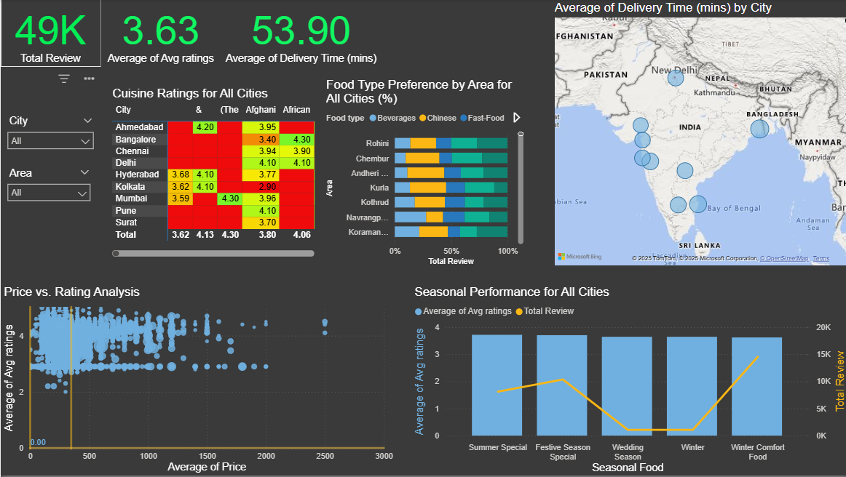
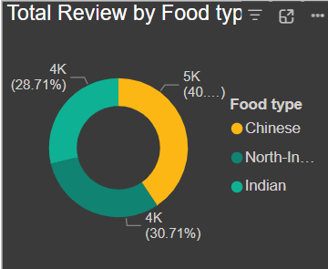
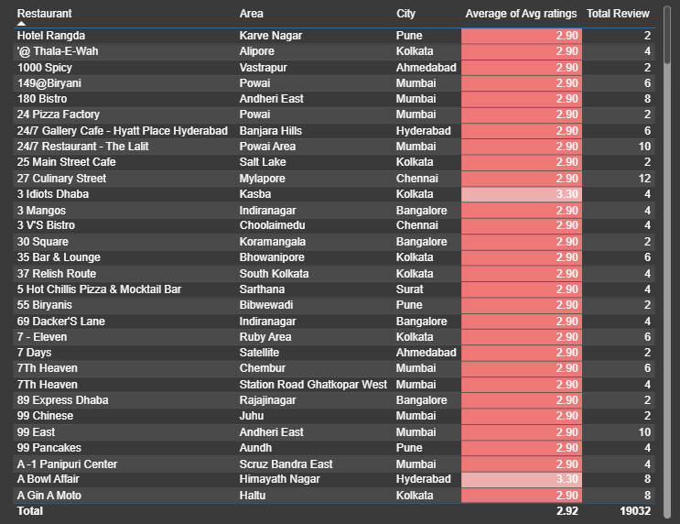
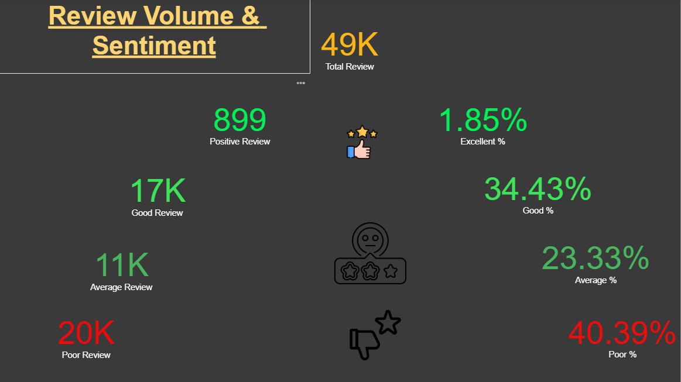
Dashboard overview

Slide 23

Conclusion from milestone
Conclusion of Insights
The sentiment analysis reveals that while customer feedback is a powerful tool for shaping brand strategies, significant gaps in delivery time, pricing, and food categories are contributing to dissatisfaction. By leveraging data-driven insights, food brands can optimize their operations, refine their offerings, and align their pricing strategies to customer expectations. These improvements will not only enhance customer satisfaction but also build long-term brand trust and loyalty.

Slide 24


Thank you
Team : 06
We appreciate the opportunity to present our project on Customer Sentiment & Food Trend Analysis. Your feedback and suggestions will help us improve and take this work further.
Thank you for your time and attention!

